Slide 1
Introduction to GIS

Slide 2
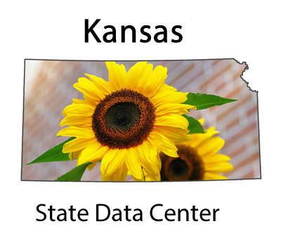
Thank You!
Xan Wedel
Sr. Research Data Engineer
Institute for Policy & Social Research
607 Blake Hall
xan@ku.eu

Slide 3
Overview
What is GIS?
Why use GIS?
Hands-on – Getting Started with ArcGIS Online
Hands-on – Applied ArcGIS

Slide 4
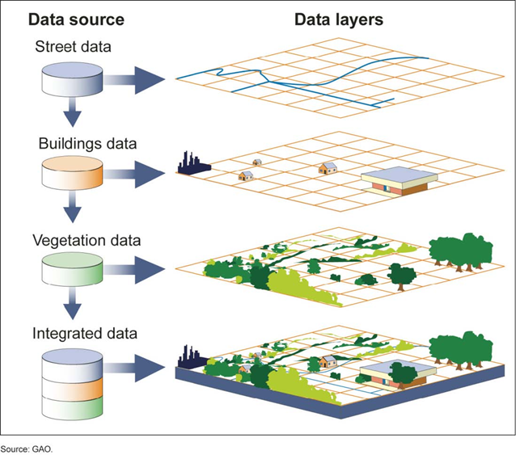
What is GIS?
Geographic Information System (GIS)
A tool to visualize, join, and analyze data.
Notes:
Vector data – points, lines, or polygons
Raster data – satellite imagery, elevation, land use/land cover, etc.

Slide 5
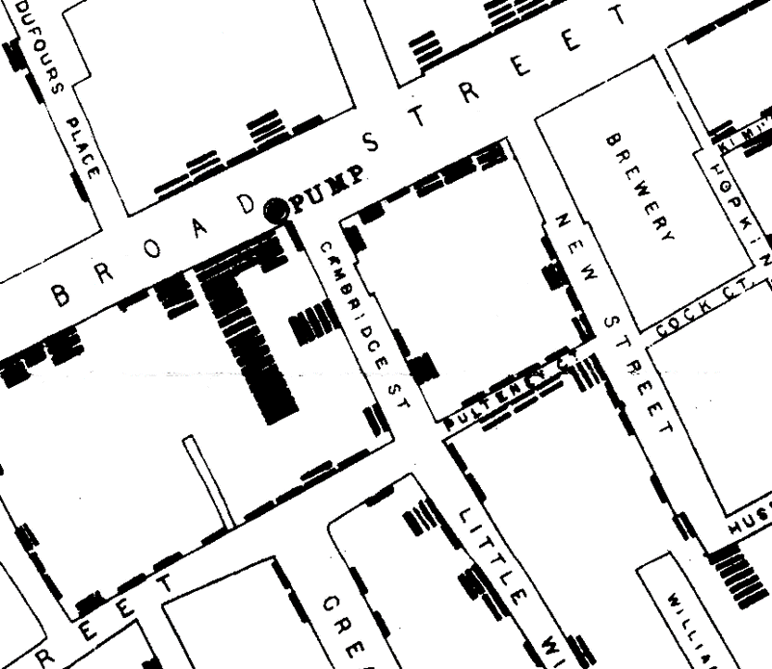
Why use GIS?
In 1854, a cholera outbreak killed 600 people in London. The physician John Snow made this outbreak famous. John Snow used a data visualization to show that cholera is spread by contaminated water.
Notes:
At this point in history the germ theory of disease was not known. This theory proposes that micro-organism are the cause of many diseases. Since the theory was not known, the spread of cholera was a mystery to public health officials.
John Snow spoke with locals near the cholera outbreak to discover the source of the germs spreading the disease. He used a "dot distribution map" to show how the cholera cases were clustered. He showed the cases were clustered around a public water pump on Broad Street.

Slide 6
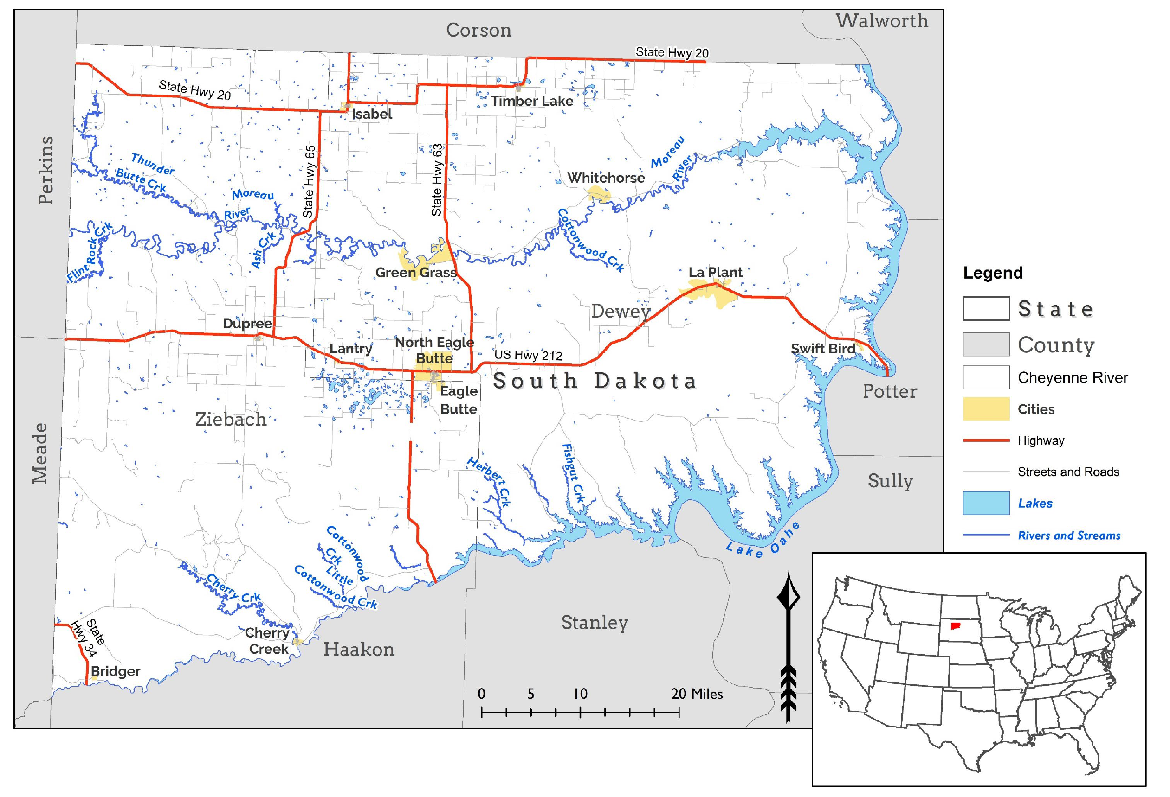
Why use GIS?
Notes:
Reference

Slide 7
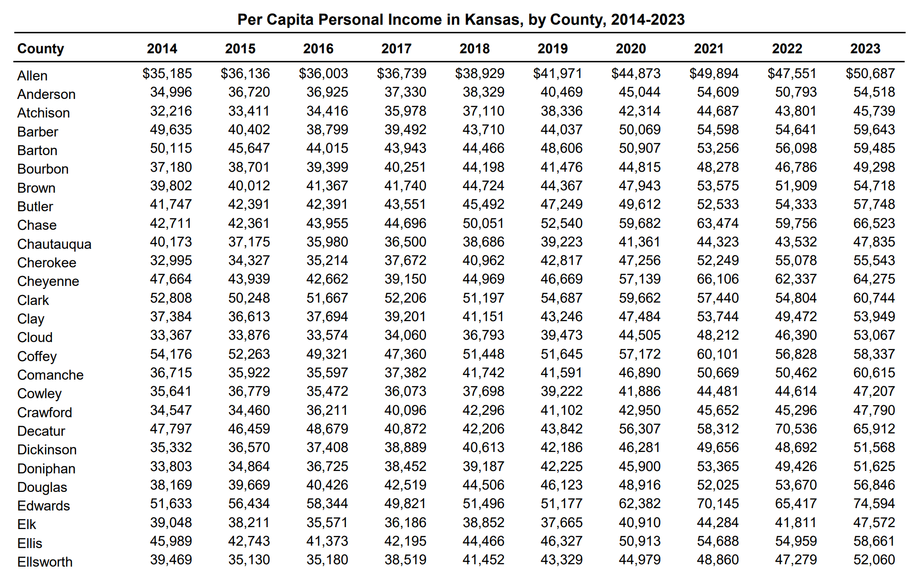
Why use GIS?
Notes:
GIS can help visualize spatial patterns.

Slide 8
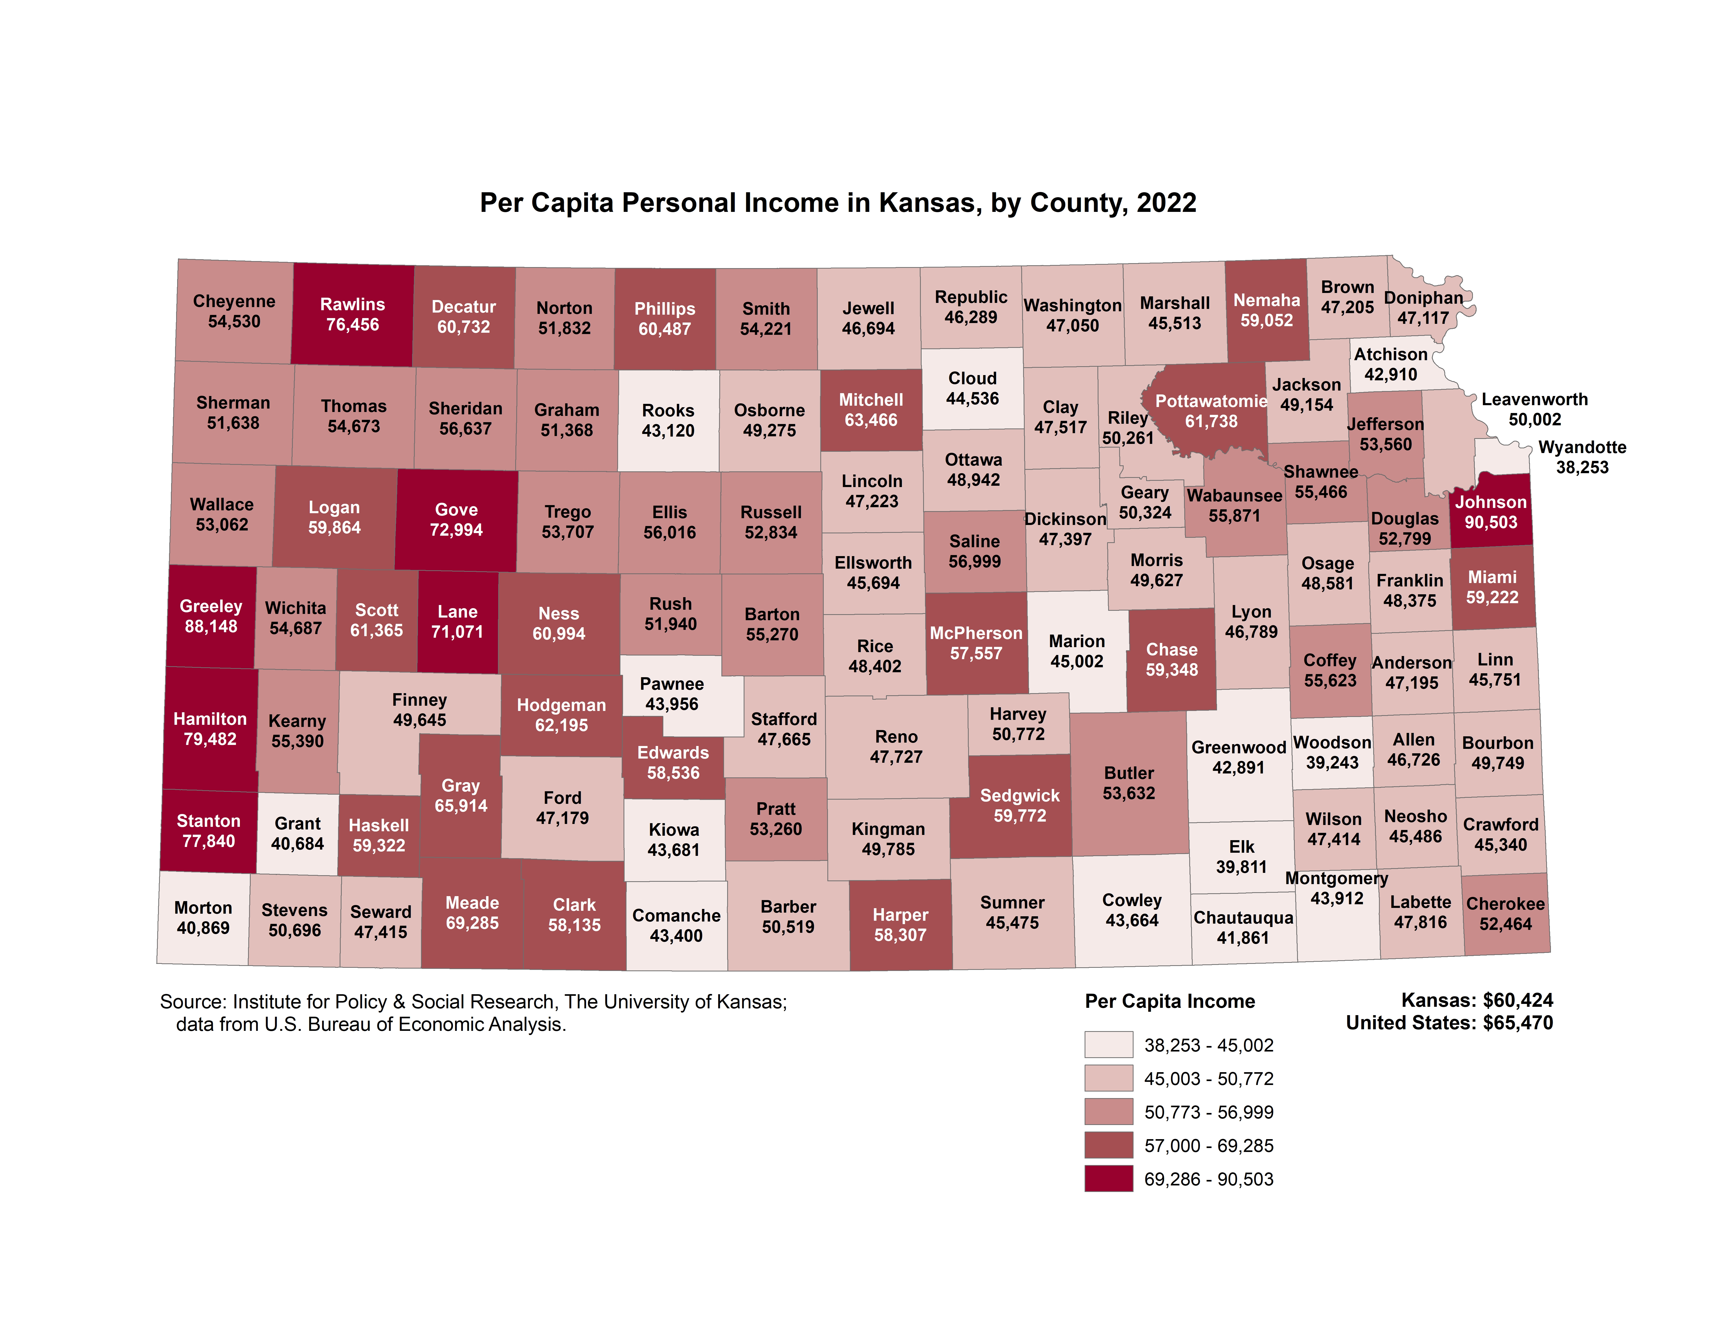
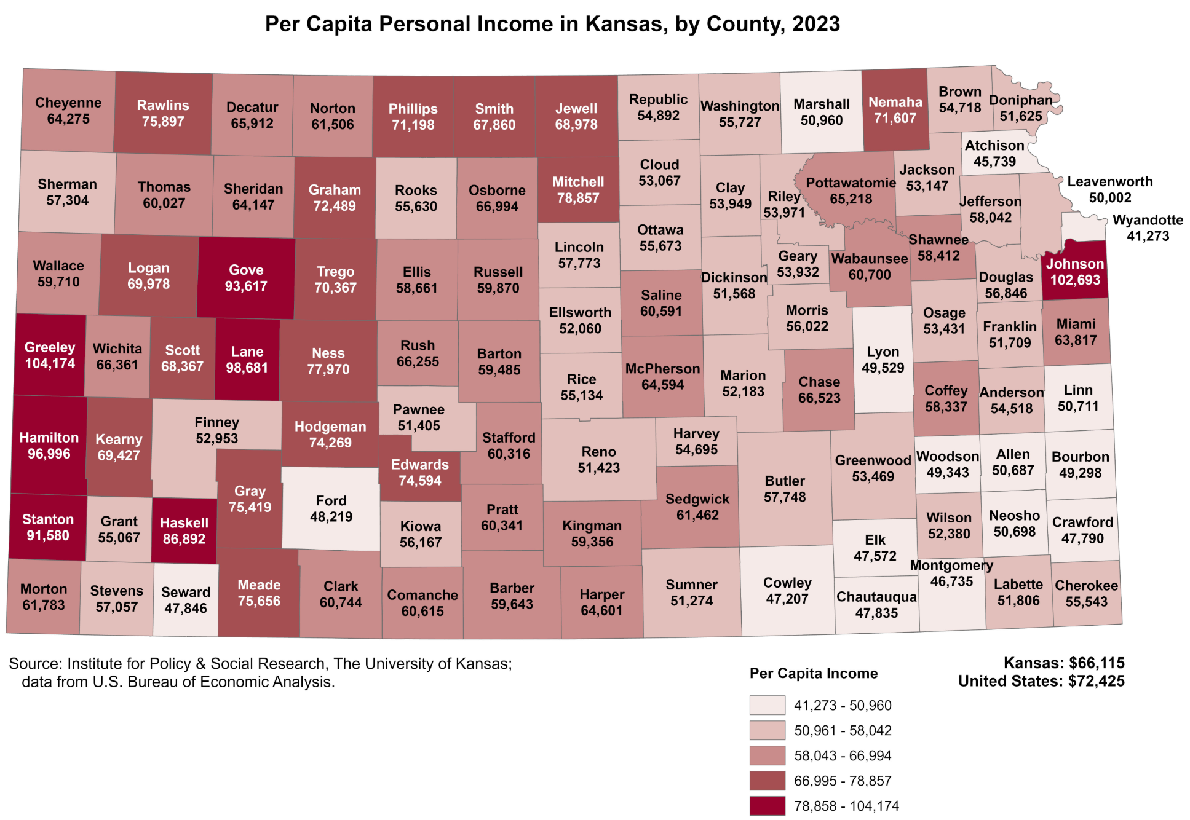
Why use GIS?
Notes:
GIS can help visualize spatial patterns.

Slide 9
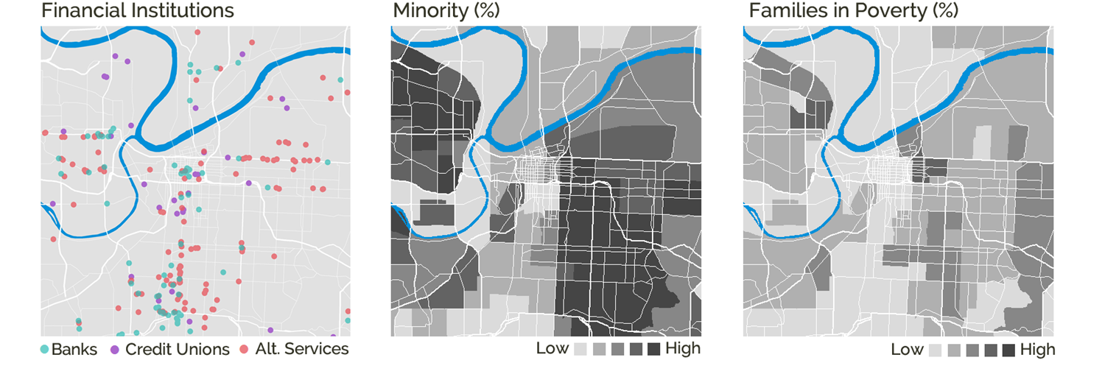
Why use GIS?
Notes:
Layer points, lines, and polygons over raster data (satellite imagery, geologic or atmospheric data, etc.)

Slide 10
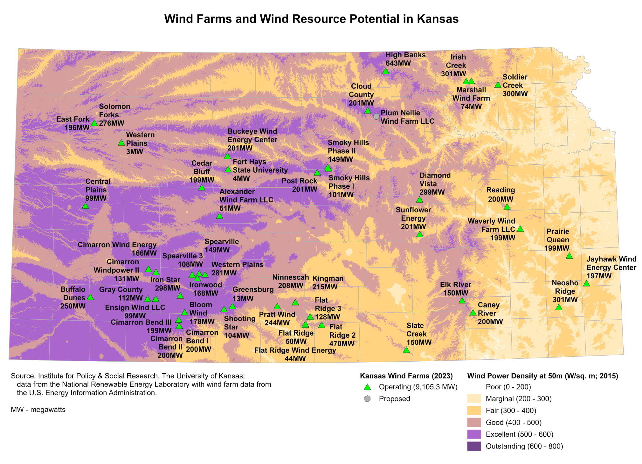
Why use GIS?
Notes:
Layer points, lines, and polygons over raster data (satellite imagery, geologic or atmospheric data, etc.)

Slide 11
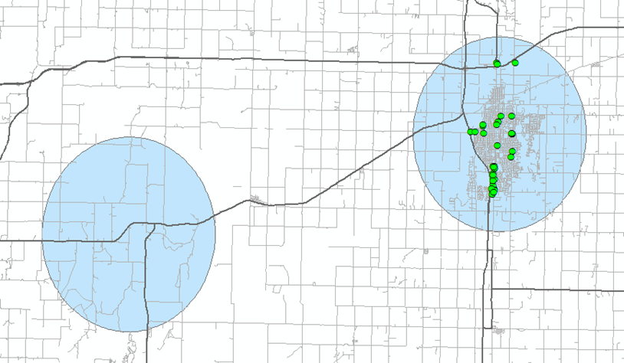
Why use GIS?
Notes:
5-mile buffer; did the participant with 34 fast food restaurants within 5 miles of home have a different outcome than the participant with no fast food restaurants within 5 miles.

Slide 12
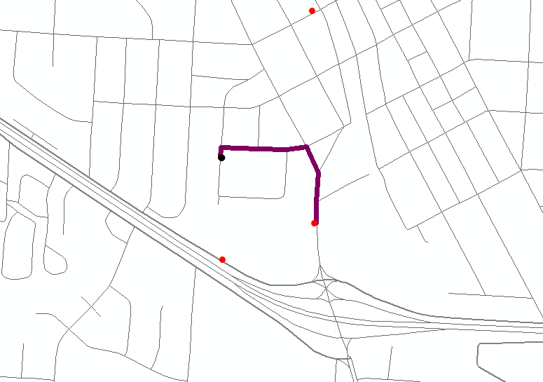
Why use GIS?
Notes:
Geocoded participants and tobacco outlets. Calculated nearest outlet to residence with shortest walking and driving distance in meters and minutes.

Slide 13
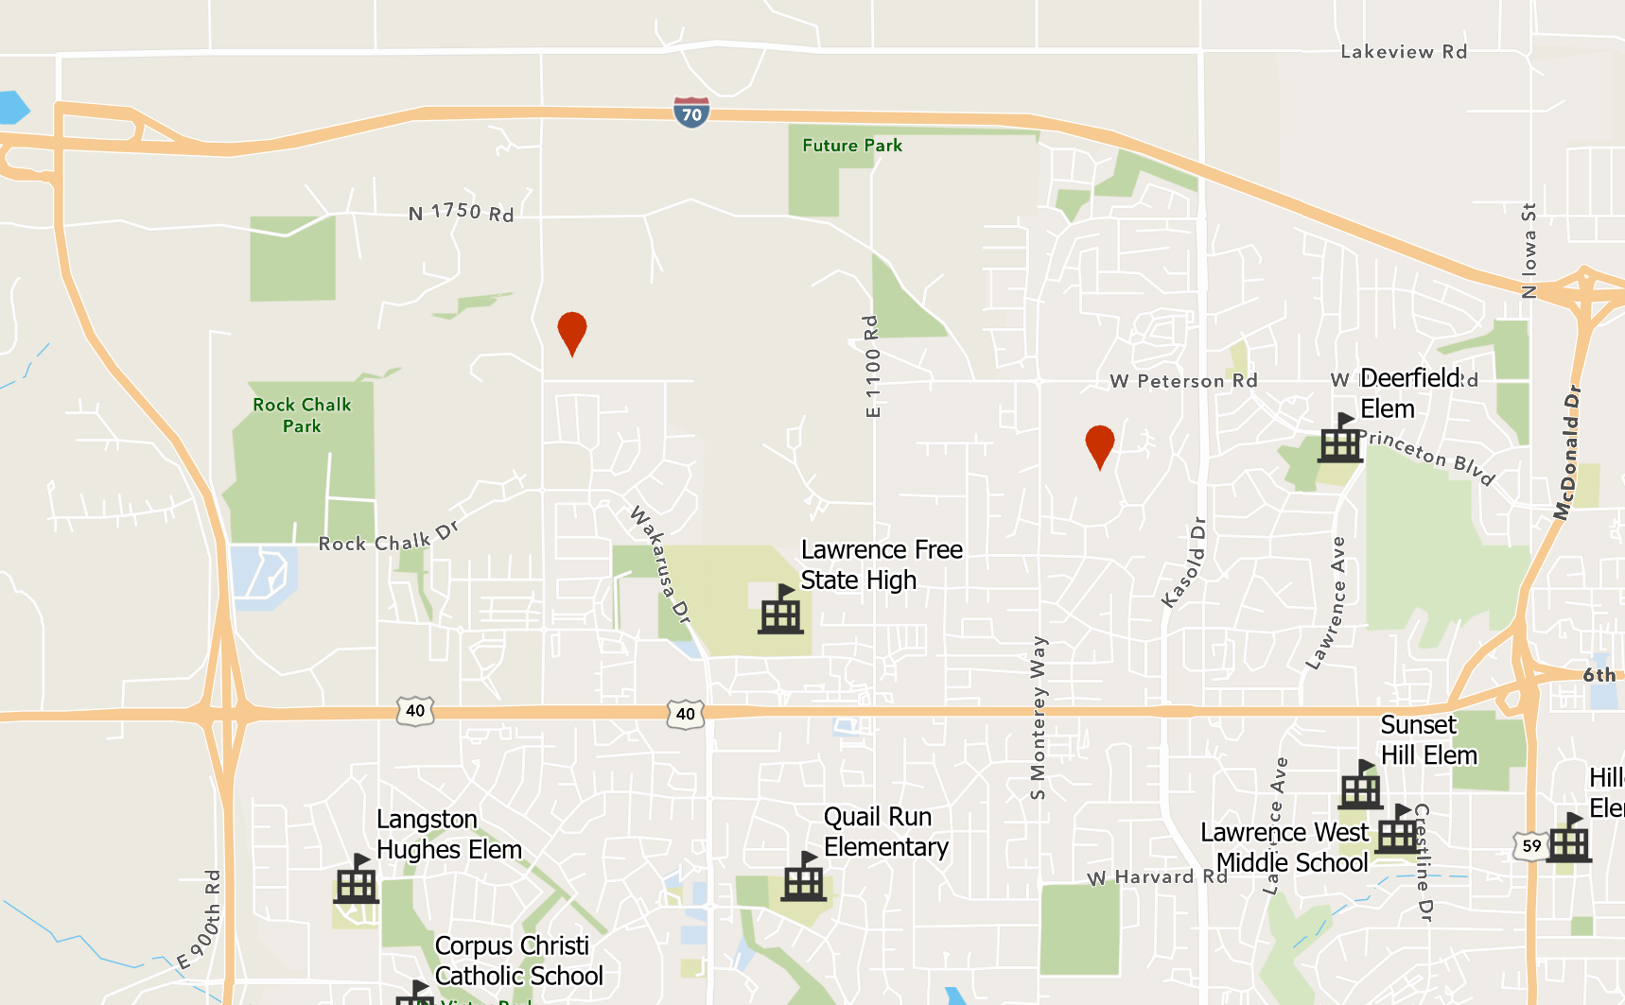
Why use GIS?
Notes:
Site selection

Slide 14
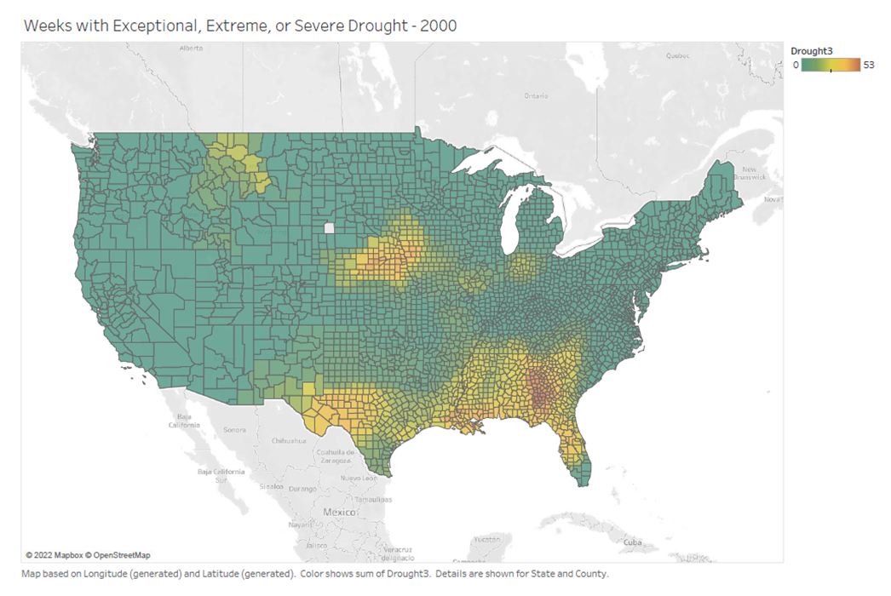
Why use GIS?
Notes:
Time series of maps - see Drought3.pdf

Slide 15
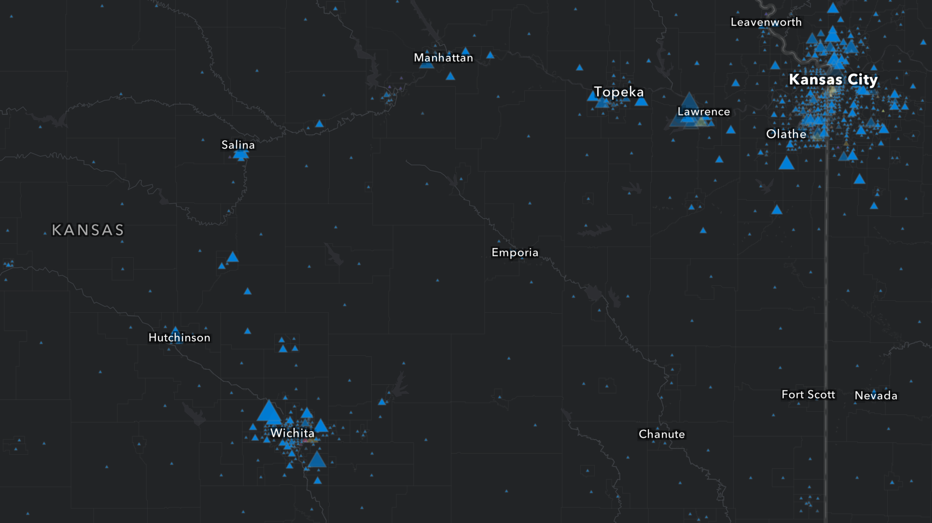
Why use GIS?
Notes:
Interactive maps

